Slide 1
Machine Learning
Chapter 04

Slide 2
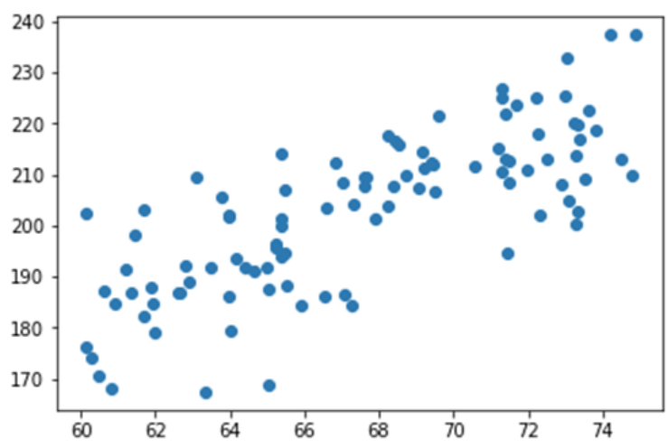
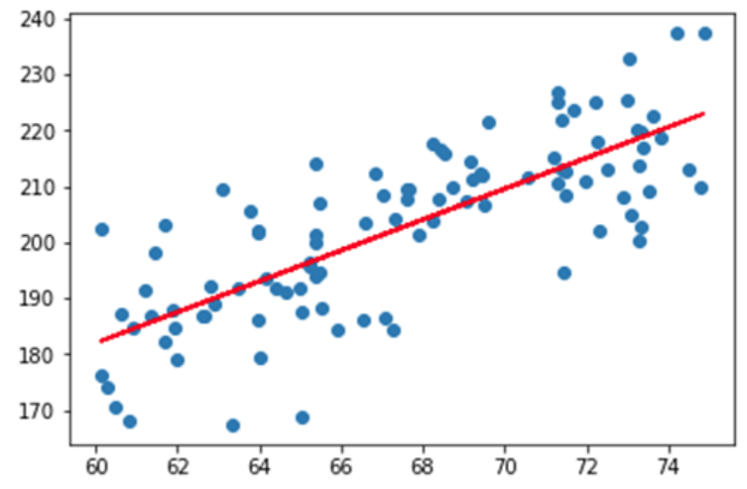
Machine Learning
A subset of artificial intelligence known as machine learning focuses primarily on the creation of algorithms that enable a computer to independently learn from data and previous experiences.
Example:
As a simple example, imagine we’ve collected data on the height and weight of 100 people.
A simple machine learning algorithm could fit a line to this data. We could then use that line to make predictions about the weight of new people given their height. One equation of a line is y = mx + b, where m is the slope of the line and b is the y-intercept. A machine learning algorithm called linear regression

Slide 3
What is Statistics
Supervised
Based on labeled data
Unsupervised
Based on un-labeled data
Reinforcement
Based on the feedback system

Slide 4
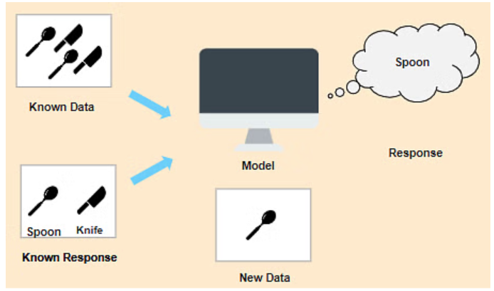
Supervised Leaning
It contains a model that is able to predict with the help of a labeled dataset.
A labeled dataset is one where you already know the target answer.
Supervised learning can be further divided into two types:
Classification
Regression

Slide 5
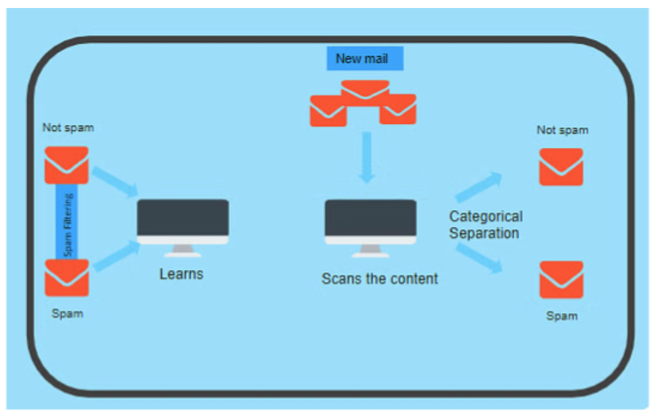
Classification- Supervised LeaRning
Classification is used when the output variable is categorical i.e. with 2 or more classes

Slide 6
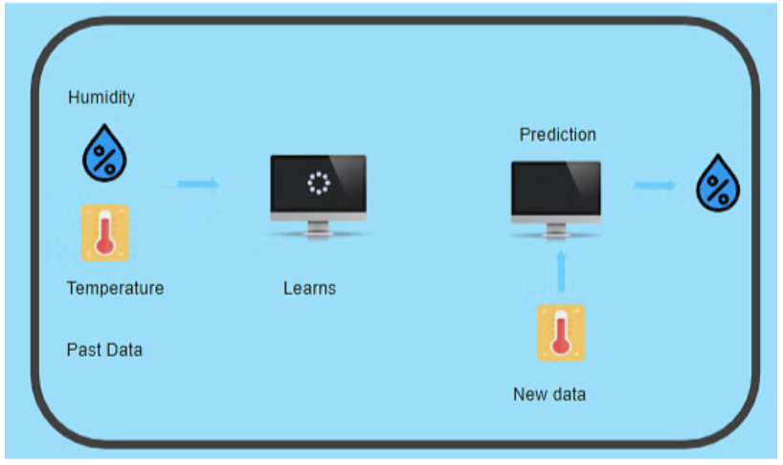
Regression-Supervised Leaning
Regression is used when the output variable is a real or continuous value (not a category).
Examples:
Predicting house prices based on size, location, number of rooms, etc
Estimating the temperature for tomorrow using weather data.
Forecasting sales for the next month on past trends.

Slide 7
Learning Curves
Machine learning models are employed to learn patterns in data.
An error may be defined as the difference between the prediction of observation and the true value of the observation.
Bias error
Bias error, also known as underfitting, Bias describes a model which makes simplified assumptions so the target function is easier to approximate; a model may learn that every 5'9 male in the world wears a size medium top - this is clearly biased.
A high-bias model fails to capture the complexity of the data and may overlook important patterns, leading to poor performance on both training and unseen data.
Variance error
Variance error, also known as overfitting,Variance describes the variability in the model prediction; how much the prediction of the model changes when we change the data used to train it.
A high variance model captures the noise and random fluctuations in the training data too closely, resulting in poor generalization to unseen data.

Slide 8
Learning Curves
Learning curves are a powerful tool to understand how your machine learning model is learning over time, especially in terms of bias and variance.
A learning curve is a plot that shows how a model's performance changes with increasing training data size (or training time). Usually, we plot:
Training score (e.g., accuracy or error on the training set)
Validation/Test score (e.g., accuracy or error on unseen data)
Training curve: The curve calculated from the training data; used to inform how well a model is learning.
Validation curve: The curve calculated from the validation data; used to inform of how well the model is generalizing to unseen instances.
These curves show us how well the model is performing as the data grows, hence the name learning curves.

Slide 9
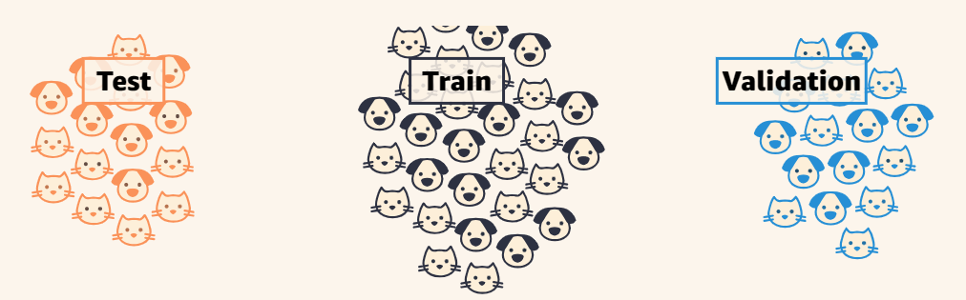
Data SET
Training Set: The dataset that we feed our model to learn potential underlying patterns and relationships. Validation Set: The dataset that we use to understand our model's performance across different model types and hyperparameter choices. It is used for evaluation during training. Test Set: The dataset that we use to approximate our model's unbiased accuracy in the wild.
Typical Data splits: Training set (60-80 %), Validation (10-20%), Test (10-20%)

Slide 10
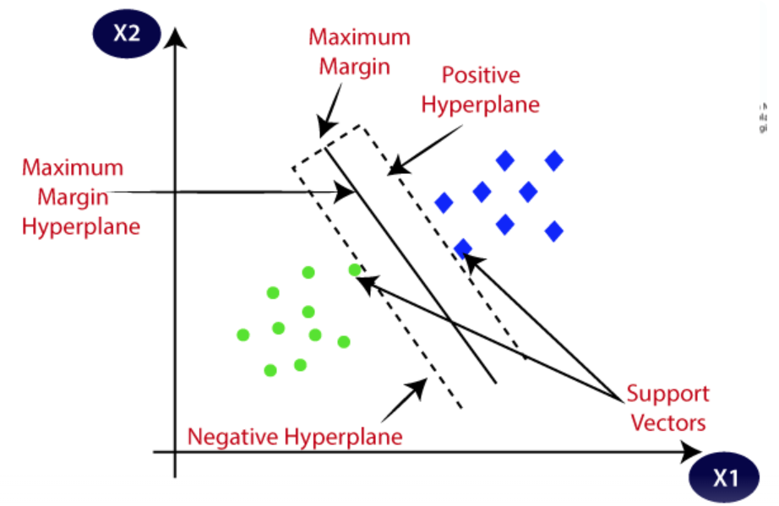
Two Popular Learning models
Support vector machines (SVM)
Random forests (RF).
Support Vector Machine:
Support Vector Machine” (SVM) is a supervised learning machine learning algorithm that can be used for both classification or regression challenges.
Plot each data item as a point in n-dimensional space (where n is the number of features you have).
Perform classification by finding the optimal boundary (hyper-plane) that differentiates the two classes very well (look at the below snapshot).

Slide 11
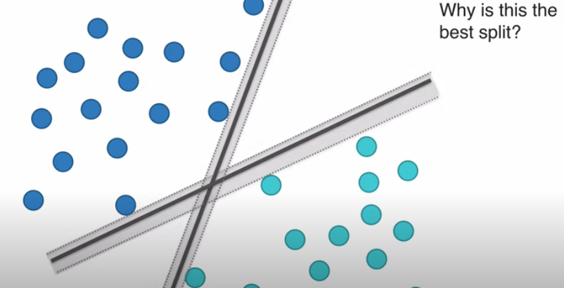
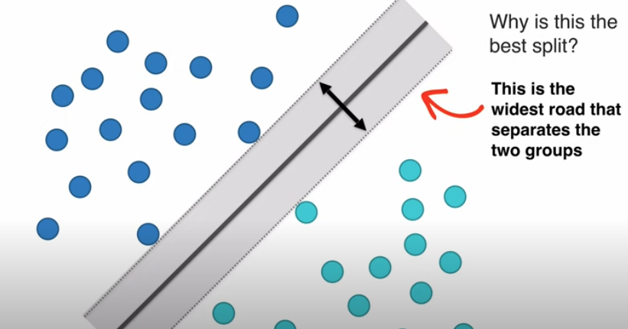
Two Popular Learning models
Support vector machines (SVM)
SVM tries to maximize the distance between the two groups to create a decision boundary that’s as far as possible from both classes.

Slide 12
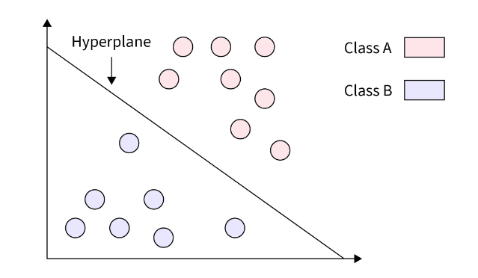
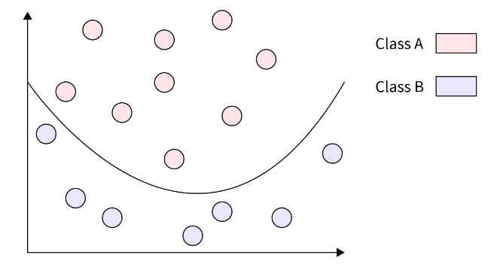
Types of SVM classifiers
Linear SVMs:
Linear SVMs are used with linearly separable data.
This means that the data do not need to undergo any transformations to separate the data into different classes.
wx + b = 0
Nonlinear SVMs:
Nonlinear SVM (Support Vector Machine) is necessary when the data cannot be effectively separated by a linear decision boundary in the original feature space.
Nonlinear SVM addresses this limitation by utilizing kernel functions to map the data into a higher-dimensional space

Slide 13
Types of SVM classifiers
Kernel Function:
Kernel Function generally transforms the training set of data so that a non-linear decision surface is able to transform to a linear equation in a higher number of dimension spaces.
Radial Basis Function (RBF): A popular and versatile kernel function that works well for various data types. It effectively maps data points to a high-dimensional space suitable for non-linear separation. Its a good default choice.
Polynomial Kernel: This kernel raises the input data points to a certain power, essentially creating new features based on interactions between existing features. The choice of the power parameter determines the complexity of the non-linear mapping.
Sigmoid Kernel: Another option for non-linear mapping, but it can suffer from numerical issues in some cases.

Slide 14
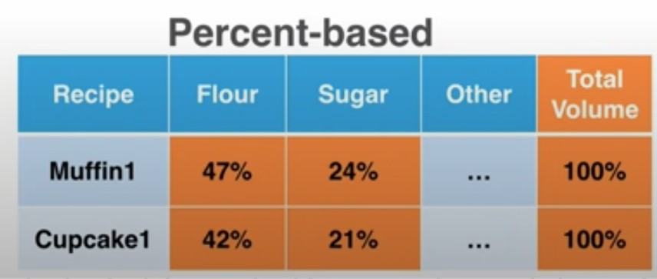
Types of SVM classifiers
Linear SVM (Example)
Classify cupcakes and muffins
Steps:
Find the data
Apply data science model
Review results
1. Find the data
2. Apply data model
Import Libraries (pandas, numpy, sklearn)
Import Data
Prepare the data (sugar and butter features)
Fit the Model (kernel = Linear)
Visualize Results
Predict new case

Slide 15
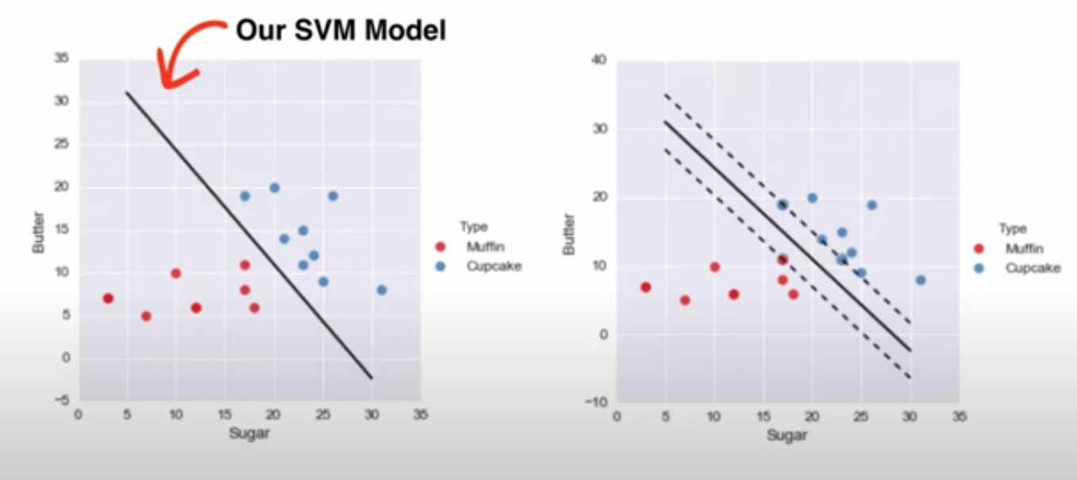
Types of SVM classifiers
Linear SVM (Example)

Slide 16
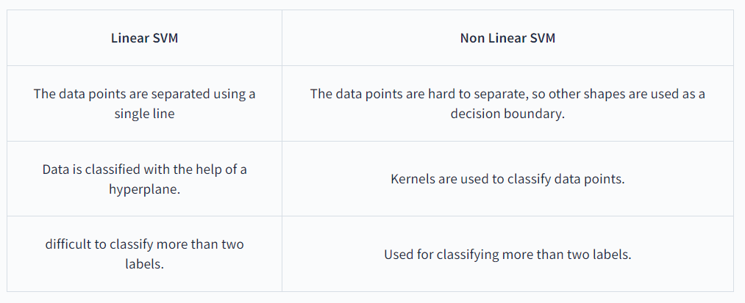
Types of SVM classifiers

Slide 17
Random Forest
The Random Forest Algorithm is a supervised machine learning algorithm.
It is used for Classification and Regression problems in Machine Learning.
It constructs an ensemble of decision-tree classifiers and uses random selection to create multiple forests from which the final prediction is made.
The more trees, the more it will be robust.
It can handle the data set containing continuous variables, as in the case of regression, and categorical variables, as in the case of classification.

Slide 18
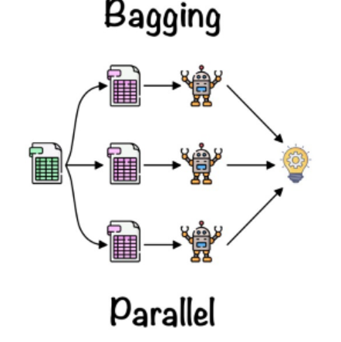
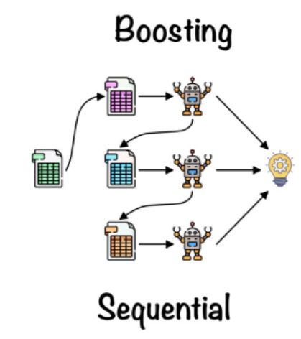
Types of random Forest
Bagging
It creates a different training subset from sample training data with replacement & the final output is based on majority voting. For example, Random Forest.
Boosting
It combines weak learners into strong learners by creating sequential models such that the final model has the highest accuracy. For example, ADA BOOST, XG BOOST.

Slide 19
Regression Analysis
Regression is a method for understanding the relationship between independent variables or features and a dependent variable or outcome.
It’s used as an approach to predict continuous outcomes in predictive modeling.
Example:
Forecasting continuous outcomes like house prices, stock prices, or sales.
Predicting the success of future retail sales or marketing campaigns to ensure resources are used effectively.
Predicting customer or user trends, such as on streaming services or e-commerce websites.
Analysing datasets to establish the relationships between variables and an output.
Predicting interest rates or stock prices from a variety of factors.
Creating time series visualisations

Slide 20
Types of Regression Analysis
Simple Linear Regression
Multiple linear regression
Logistic regression

Slide 21
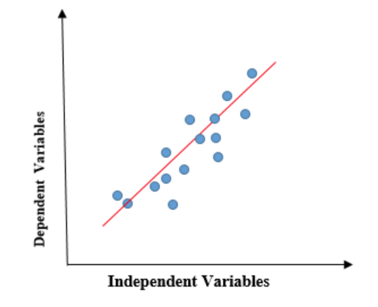
Linear Regression
Simple Regression:
Linear regression shows the linear relationship between the independent variable (X-axis) and the dependent variable (Y-axis), consequently called linear regression.
When the value of x (independent variable) increases, the value of y (dependent variable) is likewise increasing.
The red line is referred to as the best fit straight line.

Slide 22
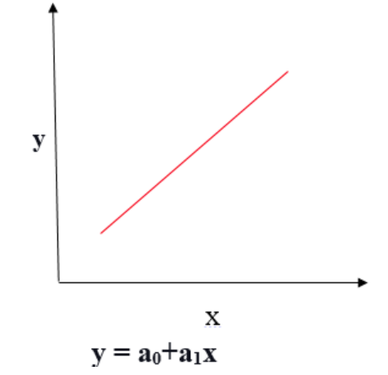
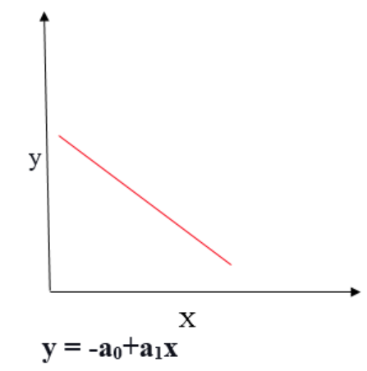
Linear Regression
Positive Linear Regression:
If the dependent variable expands on the Y-axis and the independent variable progress on X-axis, then such a relationship is termed a Positive linear relationship.
Negative Linear Regression:
If the dependent variable decreases on the Y-axis and the independent variable increases on the X-axis, such a relationship is called a negative linear relationship.

Slide 23


Linear Regression
y = a + bx
y= Dependent Variable. x= Independent Variable. a = intercept of the line. b = Linear regression coefficient.

Slide 24
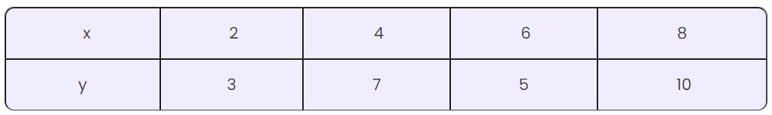
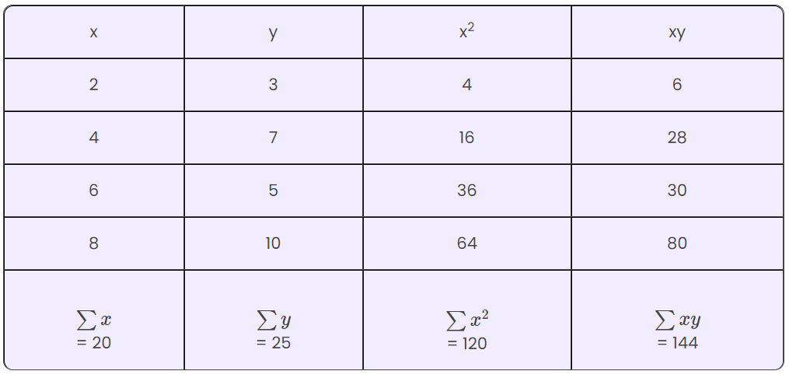
Linear Regression
Example:
b = 0.95, a = 1.5
y = 1.5 + 0.95 x

Slide 25
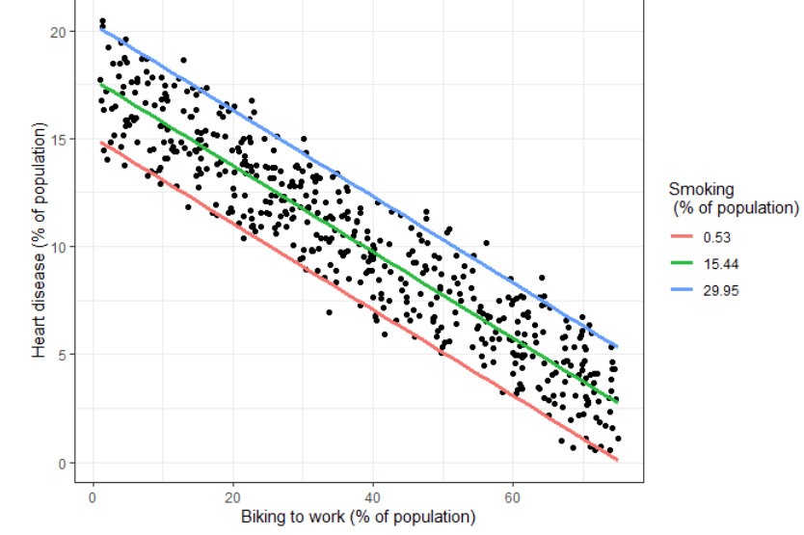
Multiple Linear Regression
Multiple Regression:
Multiple linear regression is used to estimate the relationship between two or more independent variables and one dependent variable.
Example:
How strong the relationship is between two or more independent variables and one dependent variable (e.g. how rainfall, temperature, and amount of fertilizer added affect crop growth).
The value of the dependent variables at a certain value of the independent variables (e.g. the expected yield of a crop at certain levels of rainfall, temperature, and fertilizer addition).

Slide 26

Multiple Regression
let us try to find out the relation between the distance covered by an UBER driver and the age of the driver, and the number of years of experience of the driver.
find the relation between the GPA of a class of students, the number of hours of study, and the student’s height.
find out the relation between the salary of a group of employees in an organization, the number of years of experience, and the age of the employees.

Slide 27
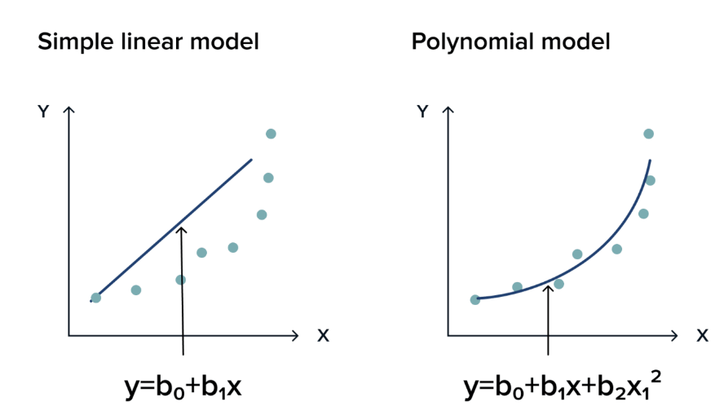
Polynomial Regression
Polynomial Regression:
Polynomial regression is needed when there is no linear correlation fitting all the variables. So instead of looking like a line, it looks like a nonlinear function. Let’s delve deeper into this type of regression.

Slide 28

Polynomial Regression
A marketing manager wants to understand the relationship between marketing budget and product sales. They have data on past marketing expenditures and corresponding sales figures.
Why Linear Regression Might Not
A linear regression model might assume a proportional increase in sales with every dollar spent on marketing.

Slide 29
Unsupervised Learning

Slide 30
Clustering
Clustering is the task of dividing the unlabeled data or data points into different clusters.
The clustering process aims to segregate groups with similar traits and assign them into clusters.
Hard Clustering: Each input data point either fully belongs to a cluster or not. For instance, in the example above, every bachelor student is assigned to one group/semester out of the 8 semesters.
Soft Clustering: Rather than assigning each input data point to a distinct cluster, it assigns a probability or likelihood of the data point being in those clusters. For example, a student enrolled in different courses so probability assign that he belongs to the specific semester?

Slide 31
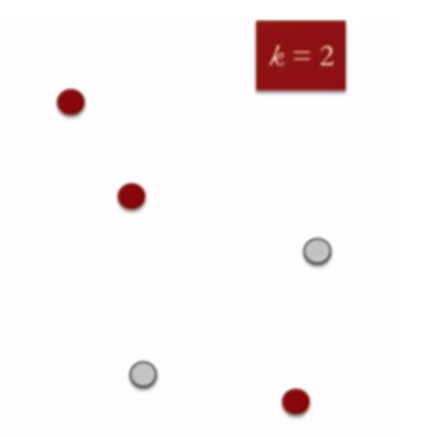
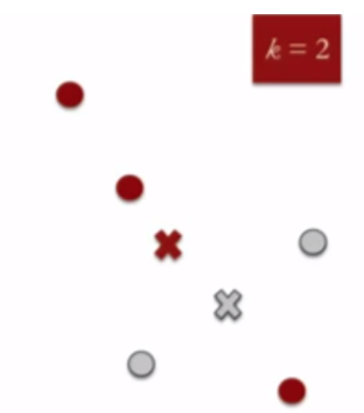
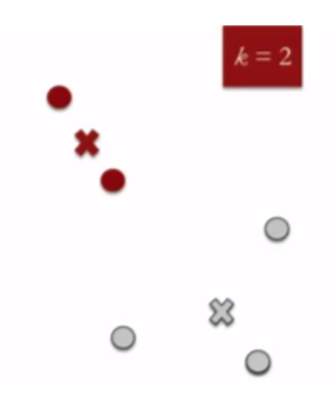
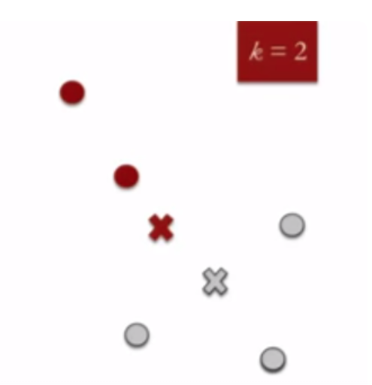
K-Mean Clustering
Define the number of clusters k=2
and randomly assign data points to cluster
2. Calculate the centroids of the cluster
3. Assign data points to its nearest centroids clusters
Re-compute centroids of the cluster
Repeat step 3 & 4 until no improvement

Slide 32
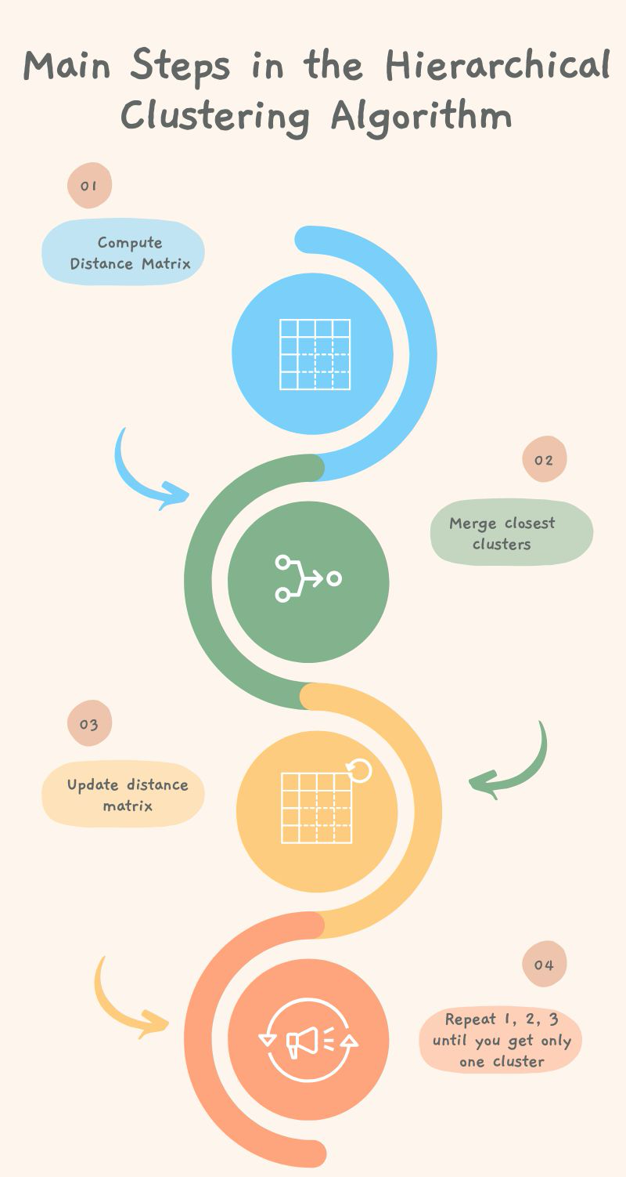
Hierarchical Clustering
A hierarchical clustering approach is based on the determination of successive clusters based on previously defined clusters.
It's a technique aimed more toward grouping data into a tree of clusters called dendrograms.
The hierarchical clustering technique has two approaches:
Agglomerative: Agglomerative is a bottom-up approach, in which the algorithm starts with taking all data points as single clusters and merging them until one cluster is left.
Divisive: The divisive algorithm is the reverse of the agglomerative algorithm as it is a top-down approach.

Slide 33
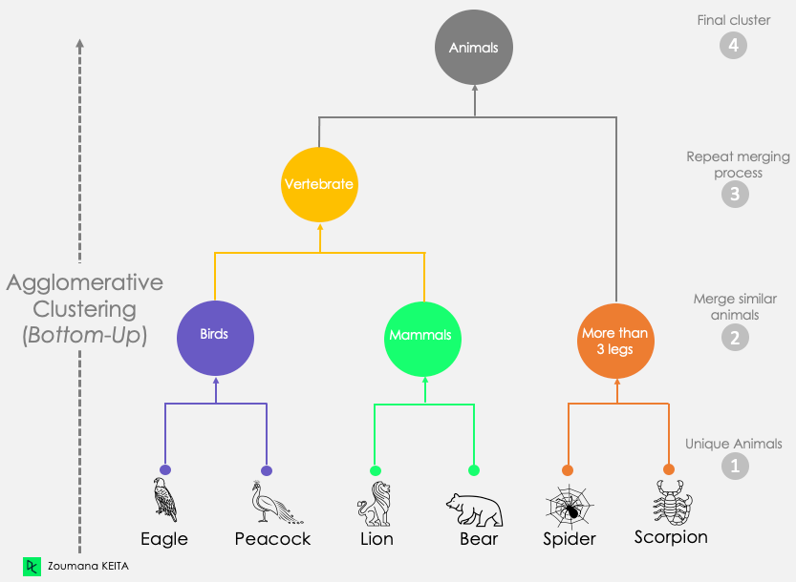
Agglomerative Hierarchical Clustering

Slide 34
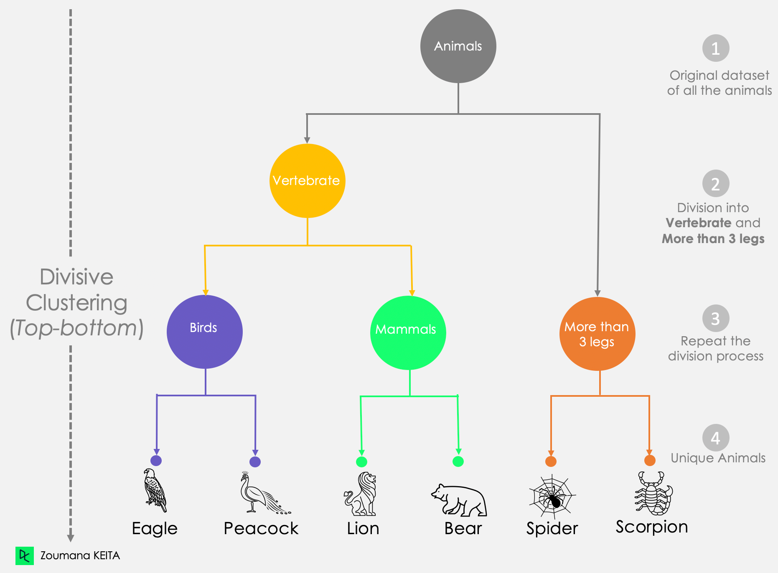
Divisive Hierarchical Clustering

